Slide 1
Deployment and Operations for Software Engineers 2nd Ed
Chapter 13 – post Production

Slide 2
Outline
Testing in production Service level thresholds Incident response

Slide 3
Testing in Production
There are two different types of testing that can happen after your service has been deployed.
Live testing where known problems are introduced into your system and the response measured. Chaos Engineering is a term for this type of testing.
Passive testing where scanners look for various types of problems and, may, perform remediation action.

Slide 4
Chaos Engineering
Chaos engineering uses experimentation to ensure system availability to withstand turbulent conditions in production (or staging) environment
It is about building trust and confidence from chaos

Slide 5
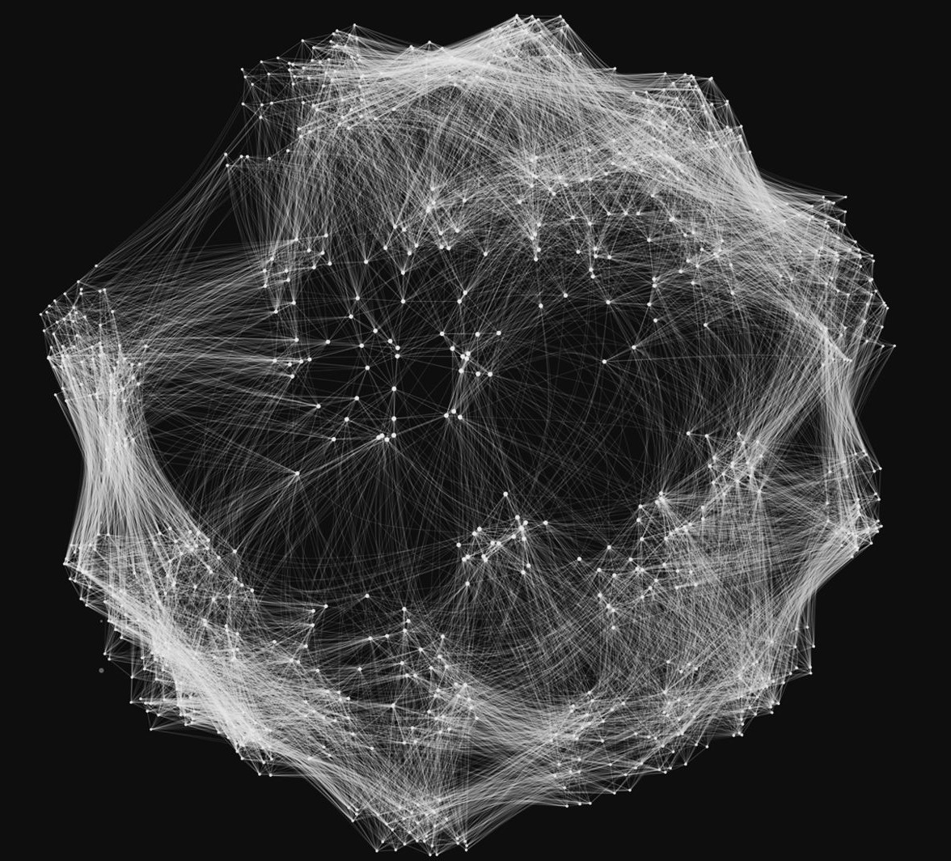
System Complexity
Production systems have evolved beyond our human ability to mentally model
Speed, Scale, & Complexity of Modern Software is Challenging behavior

Slide 6
Chaos Engineering Principles/Practice
Build a Hypothesis around Steady State Behavior
Focus on the measurable output of a system, rather than internal attributes of the system
Vary Real-world Events
Prioritize events either by potential impact or estimated frequency
https://principlesofchaos.org

Slide 7
Chaos Engineering Principles/Practice
Run Experiments in Production
Systems behave differently depending on environment and traffic patterns
Automate Experiments to Run Continuously
Build automation into the system to drive both orchestration and analysis
Minimize Blast Radius
ensure the fallout from experiments are minimized and contained

Slide 8
Define Hypothesis(Experiments)
Brainstorm: What can go Wrong?
What if DB is down?
What if Service responds slower?
What if Service Responds Slowly?
What if a Pod/Container Dies?
What if LoadBalancer stops?
What if Autoscaler not able to add new resource?
What if Cloud Policy changed?
What if Infrastructure is misconfigured.
What if…..

Slide 9
Chaos Engineering tools
Chaos Monkey - A resiliency tool that helps applications tolerate random instance failures.
orchestrator - MySQL replication topology management and high availability
kube-monkey - An implementation of Netflix's Chaos Monkey for Kubernetes clusters.
Gremlin Inc. - Failure as a Service.
Chaos Toolkit - A chaos engineering toolkit to help you build confidence in your software system.

Slide 10
Chaos Engineering tools
steadybit - A Chaos Engineering platform (SaaS or On-Prem) with auto discovery features, different attack types, user management and many more.
PowerfulSeal - Adds chaos to your Kubernetes clusters, so that you can detect problems in your systems as early as possible. It kills targeted pods and takes VMs up and down.
drax - DC/OS Resilience Automated Xenodiagnosis tool. It helps to test DC/OS deployments by applying a Chaos Monkey-inspired, proactive and invasive testing approach.

Slide 11
Chaos Engineering in action
Slack’s Disasterpiece theater (https://slack.engineering/disasterpiece-theater-slacks-process-for-approachable-chaos-engineering/)

Slide 12
Slack’s Disasterpiece theater – exercise definition
Define an exercise
Each exercise takes place at a well publicized time (within Slack)
Relevant experts either in the same room or on video
One or two hosts write a detailed plan and publicize it.
The plan lists a detailed collection of activities including what fault will be induced and what should be monitored
The plan includes a specific hypothesis tha will be texted.

Slide 13
Exercise execution
Iinduce problem in dev environment
Examine logs, etc to to verify that expected results appear
Verify that expected results occur in dev environment
If expected results occur in dev,
Induce failure in prod.
Monitor

Slide 14
Debrief
What was the time to detect and time to resolve?
Did any users notice?
Did any humans have to intervene? What was terrifying?
Was any of our documentation wrong?
Were any dashboards in Grafana out of date?

Slide 15
Environment scanners
Scanning a production system is much less disruptive than Chaos Engineering.
A scanning tool examines the production environment looking for different types of problems.
A scanning tool uses resources but does not perturb the running system except if specific problems are found.

Slide 16
Scanning tools
Conformity scanners–detects instances that aren’t coded to best practices and shuts them down, giving the service owner the opportunity to relaunch them properly. Best practices here include phenomena that are externally visible such as generating logs.
Security scanners–searches out security weaknesses. It may terminate the offending instances. It also ensures that SSL and DRM (Digital Rights Management) certificates are not expired or close to expiration. A security scanner can also check whether any new vulnerabilities have been found for the components in your production system.

Slide 17
Scanning tools
Health scanners–performs health checks on each instance and monitors other external signs of process health such as CPU and memory usage.
Janitor scanner–searches for unused resources and discards them.

Slide 18
Discussion questions
How does a janitor scanner work?
How does a security scanner work?

Slide 19
Outline
Testing in production
Service level thresholds Incident response

Slide 20
Service level agreement
An Service Level Agreement ( SLA)
Is an agreement between a service and its clients
identifies a metric (e.g., request latency for a service) and a threshold (e.g., 99% of requests will receive a response within 300 milliseconds).
A typical agreement will contain many of these metric/threshold requirements.
If the client is outside your organization, these SLAs may be part of a legal contract.

Slide 21
Service Level Objective
A Service Level Objective (SLO) is an alerting value for an SLA.
It is designed to generate an alert and is set to a value that gives you time to prevent a violation of an SLA from occurring.

Slide 22
Service Level Indicator
Some SLOs are not directly observable. Availability, for example, is a common SLA and, hence, SLO.
Availability, however, cannot be directly measured and so you define a surrogate. This is the Service Level Indicator (SLI).
The SLI for availability is typically error rates for requests. Thresholds are set in terms of SLIs.

Slide 23
Monitoring SLIs
The SLIs are monitored on some periodic basis. The period will depend on the maturity of your service (shorter when the service is newly installed), and the criticality of your service to the overall meeting of the SLA.
Instrumentation is providing measurements–placing an instrument in your software.
Telemetry is automatically sending the data gathered by an instrument to a recording site.

Slide 24
Typical SLIs
Latency and throughput. The time between a message arriving at a service and the response being returned. Recording time of arrival and time of response allows the calculation of both latency and throughput.
Request satisfaction rate. Recording a request on arrival and whether it was satisfactorily served on response is an availability measure.
Traffic. Number of requests arriving at your service per unit time.
Saturation. The measure of utilization of the resources (CPU, network, memory) that your service relies on.

Slide 25
Discussion questions
What is a quality in addition to availability that cannot be directly measured? What is an SLI for that quality?
What does an availability of 99.99% actually mean?

Slide 26
Outline
Testing in production
Service level thresholds
Incident response

Slide 27
Incidents
An Incident an event that could lead to loss of, or disruption to, an organization's operations, services or functions.
In software terms, an incident is either a performance or availability problem.
Security incidents are dealt with by security specialists who may be a portion of a response team.

Slide 28
Life cycle of an incident
An incident is detected by a monitoring system based on the threshold values you have established.
The monitoring system then sends out a page to a first responder.
The monitoring system also enters the incident in an incident repository. The incident repository is frequently called a ticketing system.

Slide 29
Life cycle of an incident
There are two goals when an incident occurs.
The immediate goal is to fix the current problem. Get the system running normally again.
The second goal is to determine the root cause of the incident so that it does
not happen again.
The first responder (possibly with assistance from others) diagnoses the cause of the incident and determines a quick fix or work around.
Once the system is working normally, the ticket is closed.

Slide 30
Post incident activities
The first responder, in conjunction with the development team, determines the root cause of the incident.
This is entered into the ticketing system.
It is the responsibility of the development team to act on the root cause.

Slide 31
Ensuring qualities
Three models for ensuring quality in systems.
“You Build it, You run it” due to Amazon
Site Reliability Engineers due to Google
Production Engineering due to Meta (Facebook)

Slide 32
You Build it, You Run it
There is another lesson here: Giving developers operational responsibilities has greatly enhanced the quality of the services, both from a customer and a technology point of view. The traditional model is that you take your software to the wall that separates development and operations and throw it over and then forget about it. Not at Amazon. You build it, you run it. This brings developers into contact with the day-to-day operation of their software. It also brings them into day-to-day contact with the customer. This customer feedback loop is essential for improving the quality of the service.
-Werner Vogels
Werner Vogels is the Amazon CTO

Slide 33
Amazon model
Developers are responsible for post-production operations.
This includes having developers carry pagers and be the first responders in the event of an operational problem.
Pager duty is rotated among team members so that no single person is always on call.

Slide 34
Analyzing the Amazon model
Assumptions. A developer
is familiar with the internals of the service,
can interpret the information collected,
provides edback as to modifications to deal with the root cause of a problem that will be heeded by fellow team members.

Slide 35
Analyzing the Amazon model
Drawbacks
This model assumes that because a service triggered an alert, the service has a problem.
The problem can stem from upstream clients or downstream dependencies.
The problem may be in the network.
A developer of a service may or may not have a good understanding of the environment in which their service operates.

Slide 36
Site Reliability Engineer
Google, Netflix, and now many other organizations have a separate team called Site Reliability Engineers (SREs).
A system is assigned to a SRE team,
A member of that team is a first responder when an incident occurs.
Pager duty is rotated among members of the team.

Slide 37
The SRE model
SREs have an overall understanding of a system and its environment.
Their knowledge is broader than that of a single service developer.
It is not as deep with any individual service.
SREs oversee monitoring and SLIs.
They also share a knowledge base of problems with the network, with systems, and with techniques for trouble shooting problems.
To encourage development teams to listen to the advice given them by SRE teams, an SRE team has the option to refuse to support particular systems.

Slide 38
Production Engineering
Production Engineering is Meta’s (Facebook) philosophy for ensuring quality systems.
A production engineer is responsible for reliability, scalability, performance, and security for production services.
They are a separate organizational unit (like SREs) but are embedded into development teams (like you build it, you run it).

Slide 39
Production Engineering
Production Engineer’s skill set is similar to SREs in that they must have a broad understanding of the infrastructure and its components.
Since they are embedded in development teams, they acquire a detailed knowledge of the internals of particular services.

Slide 40
Discussion questions
What is your reaction to your wearing a pager and being on call 24/7 for a week?
Why would a development team not act on the recommendations of the first responders?

Slide 41
END OF OF CHAP 13

